Slide 1
Fluids 2.0
Diving deeper into the world of Fluids

Slide 2
Types of Flow

Slide 3
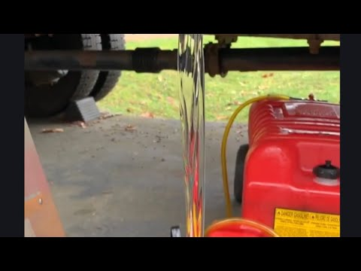
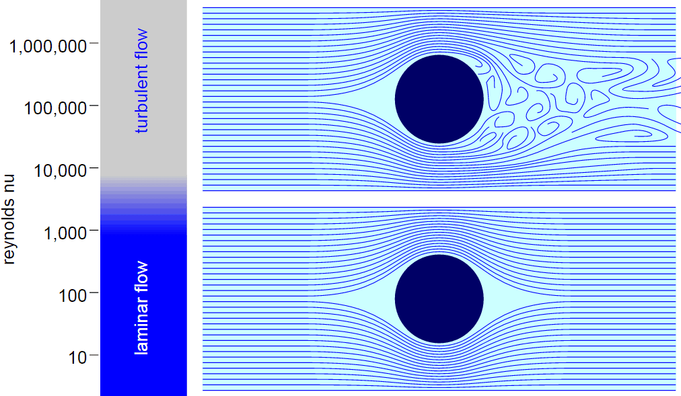
Laminar Flow
Let's look at a video!
Laminar Flow, when water travels in parallel sheets
Orderly

Slide 4
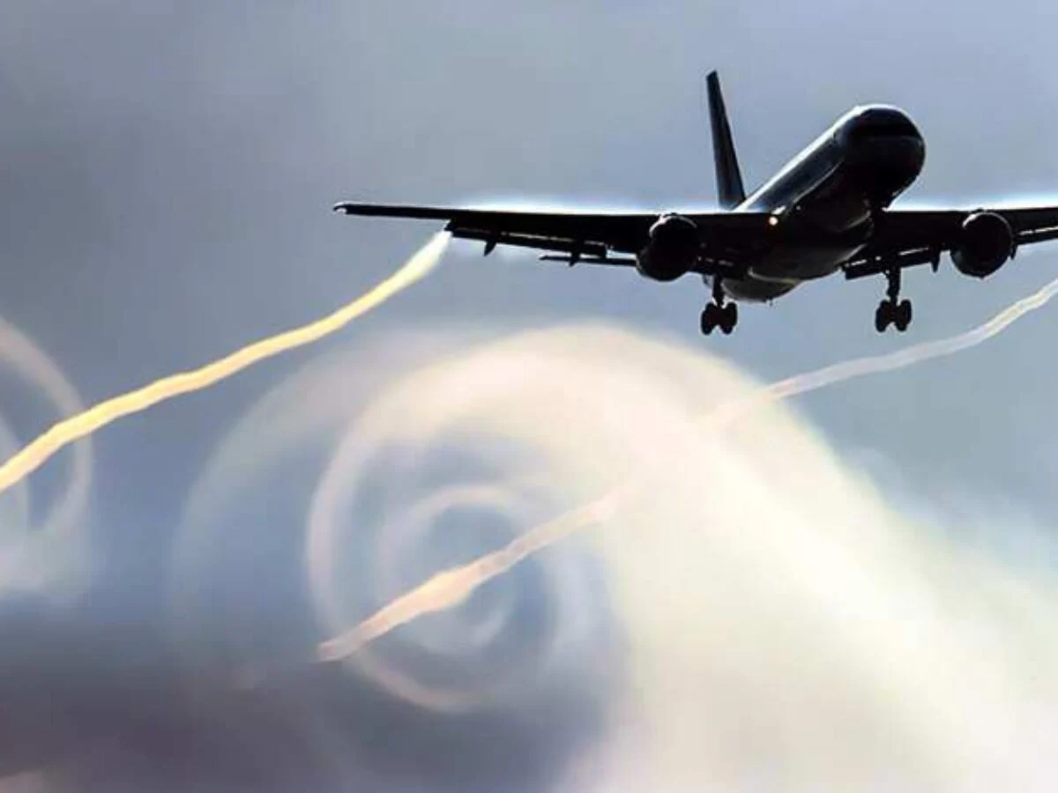
Turbulent Flow
The opposite of Laminar flow, unorderly
Eddies, the loops, are formed

Slide 5
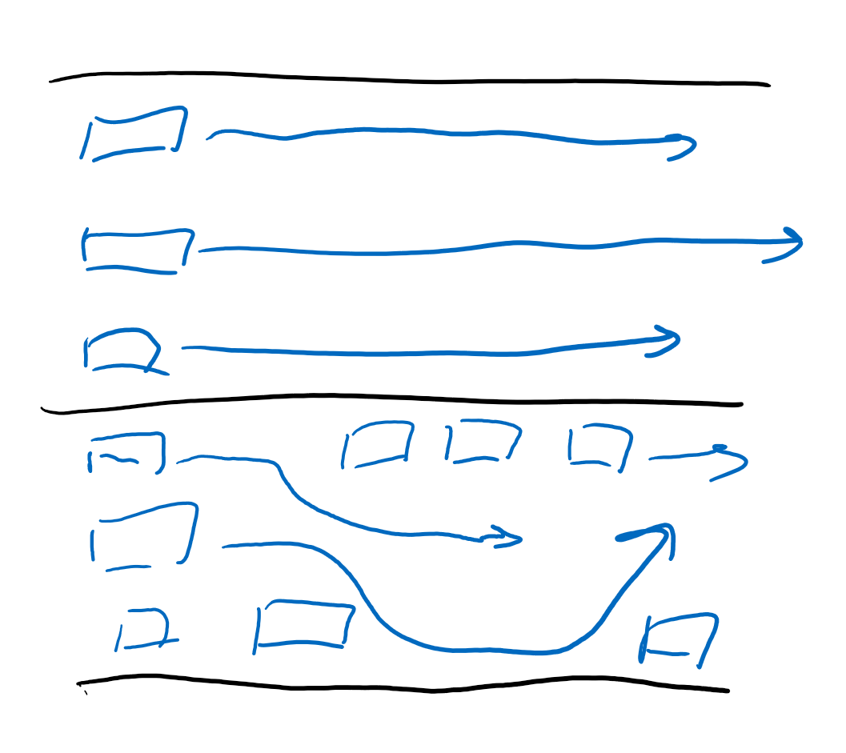
Compared to traffic
Laminar flow: no traffic, everyone booling
Turbulent flow: lots of traffic

Slide 6
Reynold’s Number

Slide 7
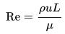
What is Reynold’s Number?
It tells us when flow is laminar and when flow is turbulent
Labeled as Re
Formula
Essentially you put numbers in, you get a number out and whatever that number is tells you what type of flow it is
Below 2000: Laminar
Above 2000: Turbulent

Slide 8
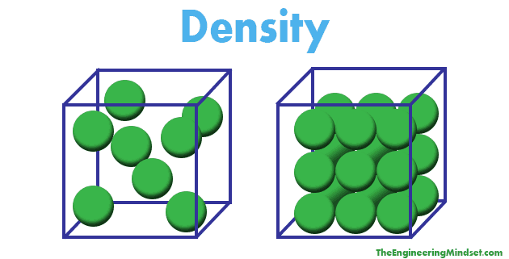
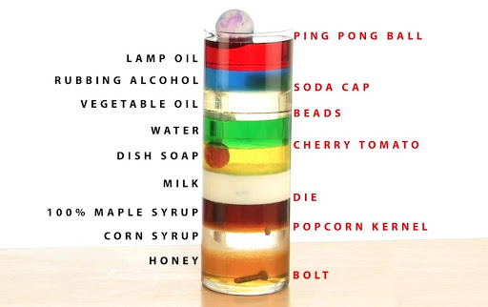
“Heaviness” and “lightness”
Density (⍴): Mass over volume
Fluids can float in others (oil on water; air on water; helium on air)
The less “dense” something is:
Less mass for same volume
“Lighter”
Less dense objects float in more dense objects

Slide 9
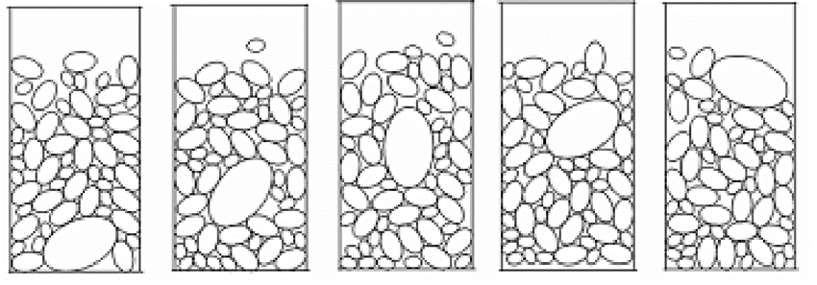
Cereal bowl (Brazil Nut Effect)
If I have a box of cereal that has really large flakes and really small flakes, and I start to shake the bag, do you expect the small or large flakes to rise up?

Slide 10
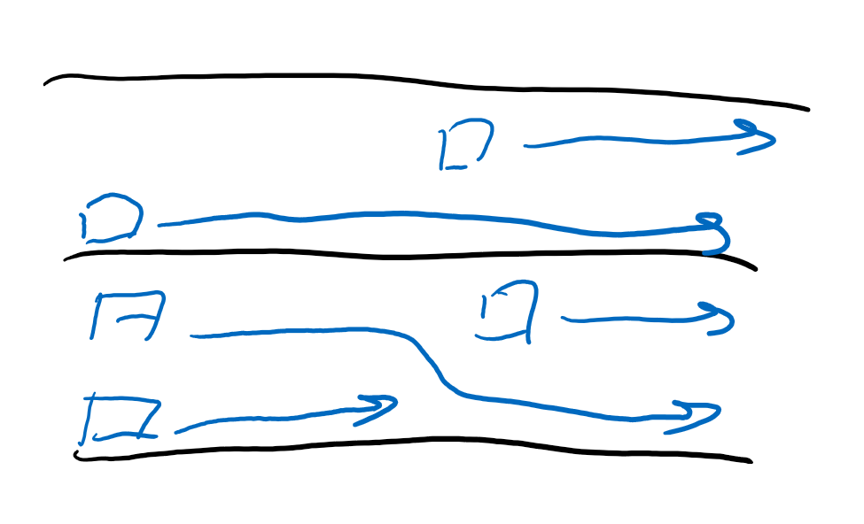
Density’s role
Density tell us how much “stuff” is near other “stuff”
The more stuff there is that is closer together, the more likely you are going to hit something

Slide 11
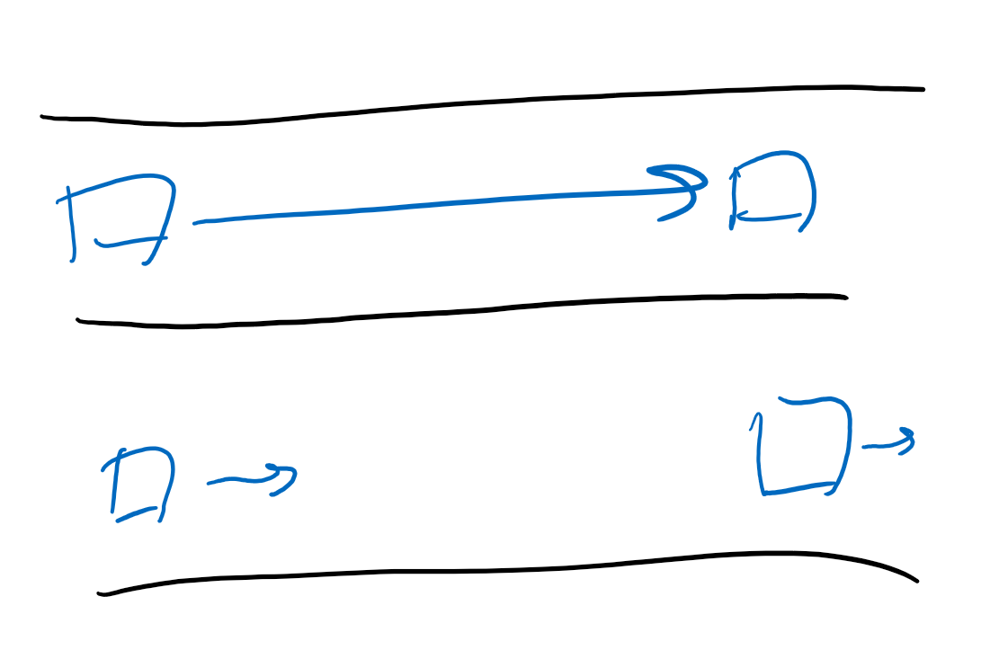
Speed of flow
Flow Speed (u):
The Faster something goes, the more likely you are going to run into other particles
Traffic

Slide 12
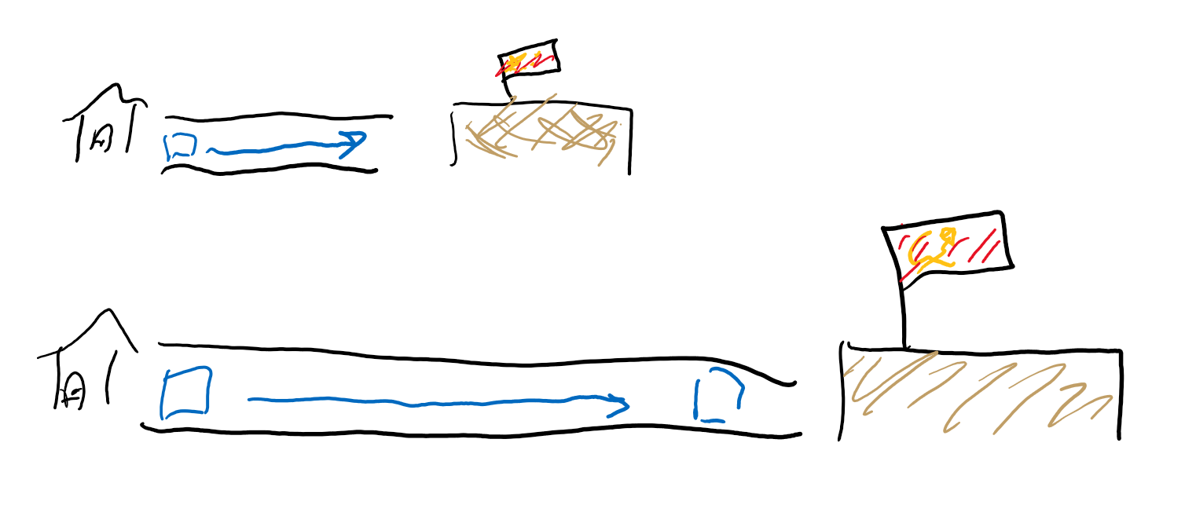
Length. . .
Length (L)
The farther you must go, the more likely you are to run into something

Slide 13
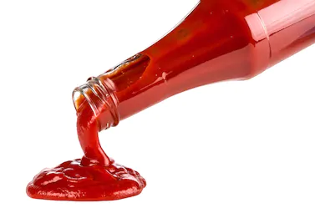
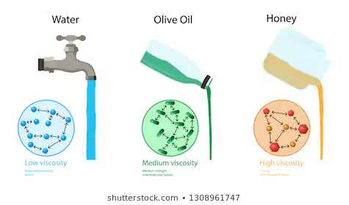
You’re goin too fast pls slow down
Viscosity (μ): Resistance to flow
Fluids that flow slower are more “viscous”
Ketchup is more viscous than water since water flows more easily than Ketchup
THIIIIIIIIIIICK

Slide 14
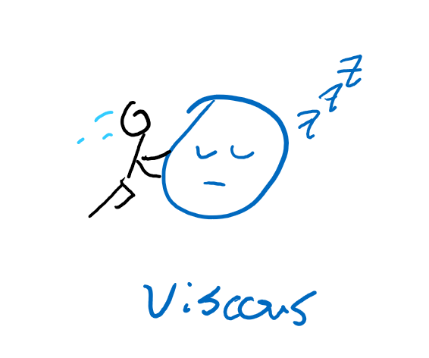
Viscosity’s role
More viscosity forces particles to have a lot more energy to become unorderly
Resistance to non laminar flow

Slide 15
Maximizing Laminar Flow
How would you do so?
Minimize numerator:
Slow moving fluids
Small length
Less Density
Maximize denominator:
High Viscosity
Turbulent flow is the opposite

Slide 16
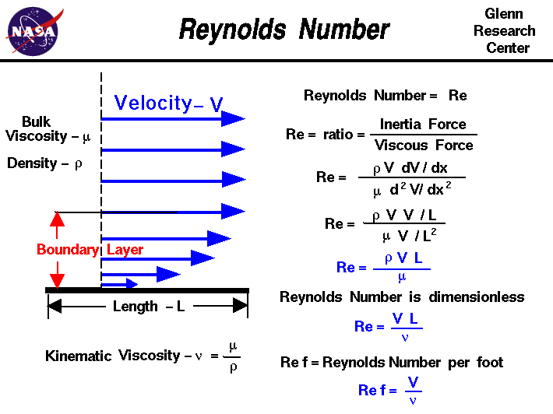
Dimensions of Reynold’s number?
⍴: Density, kg/m^3
u: Flow Speed, m/s
L: Length, m
μ: Viscosity, N·s/m^2=kg/(m*s)
⍴*u*L=kg/m^3*m/s*m=kg/(m*s)
Unitless

Slide 17
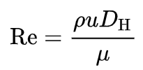
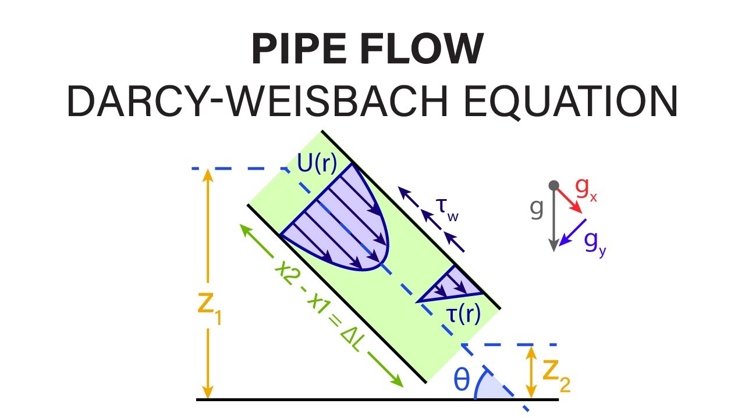
Other equations
If we’re in a pipe, we have to worry about how wide the pipe is, or the friction the pipe exerts on the fluid, or. . . a bunch of other factors

Slide 18
Review
What are the two types of flow?
What does the Reynold’s number help us determine?
What are a few things that affect the Reynold’s number?

Slide 19
Fluid forces

Slide 20
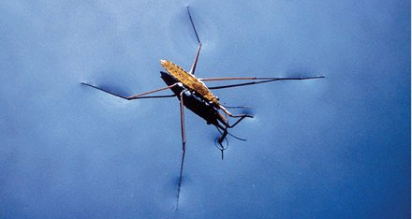
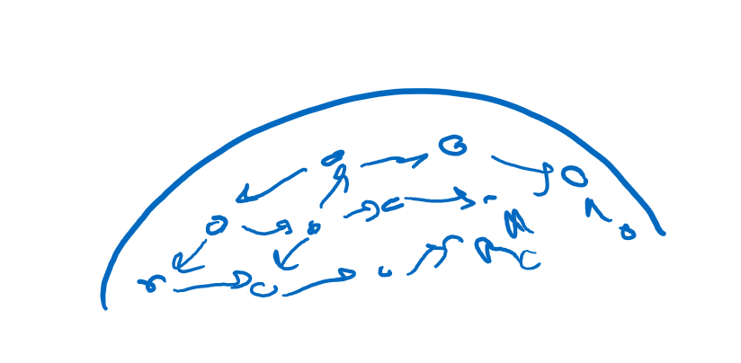
More terms
Surface tension: Attraction between molecules allows for the water to create a film
Only works for molecules that are attracted to each other, polar.

Slide 21
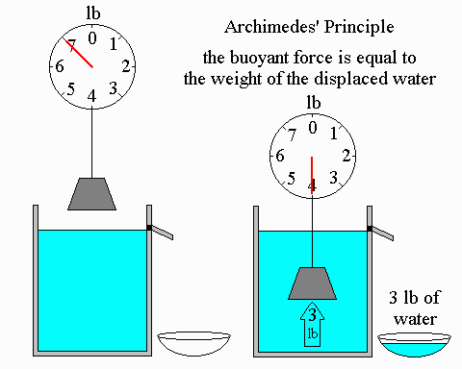
Archimedes Principle
How do objects float?
Less dense object float, but why?
Archimedes Principle!
Buoyant force is equivalent to weight of the water displaced!
Displaced water, wants to take the place, but the object here has taken its place, so the water exerts a force on the object.
Force is the same not matter how deep.

Slide 22
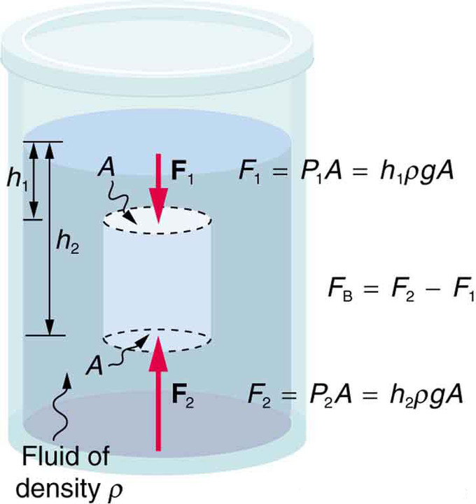
Derivations
The Math:
Force is area times pressure
Pressure is the density time height times gravity
Force is then hρgA on both the bottom and top
The total force is the difference between the heights times ρgA
hA is the volume, ρ times volume is mass, mass times g is weight

Slide 23
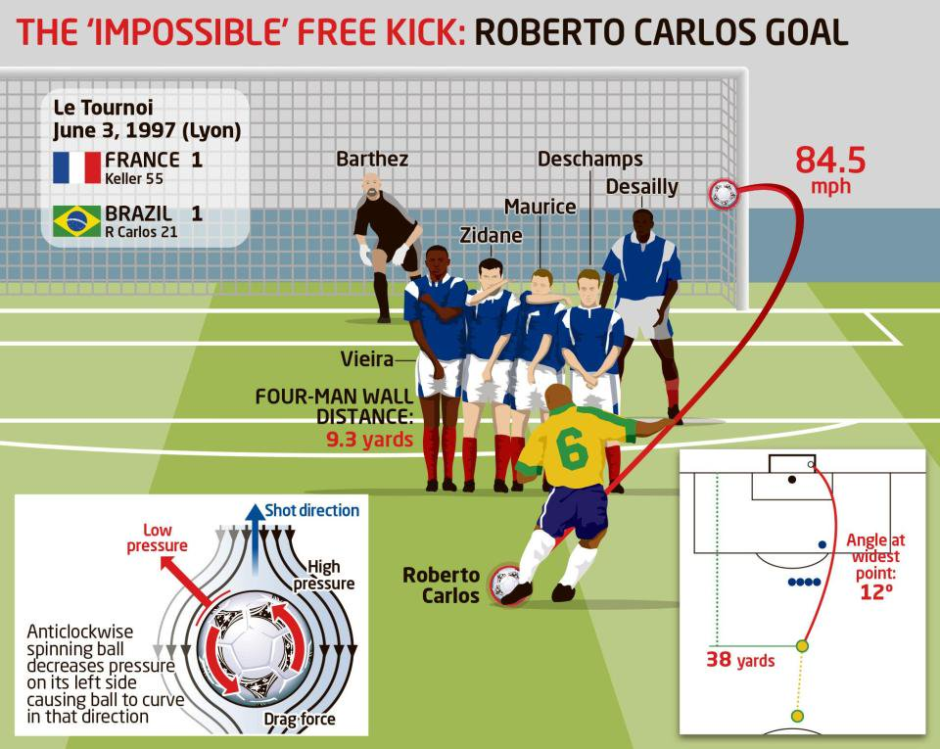
Magnus Force
A force that pulls a spinning object a direction in the air

Slide 24
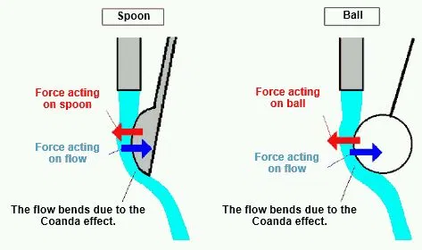
Coanda effect
Fluids like to stick to objects. . . that’s pretty much it

Slide 25
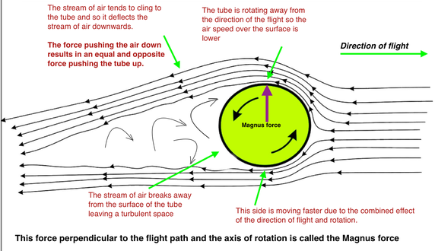
Why?
A ball is rotating in the air
Top half is rotating with wind, other half is going against wind
Top air is deflected downward
Newton’s third law

Slide 26
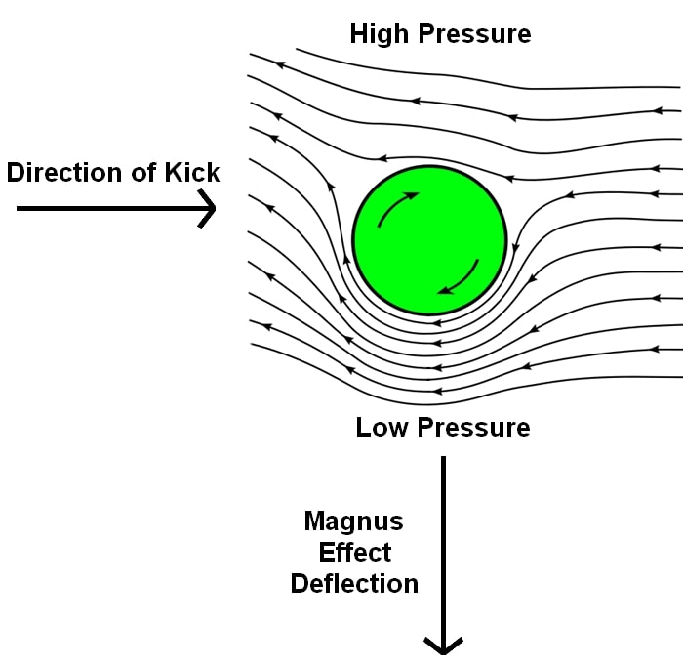
Bernoulli’s principle explanation
Air going “along with the spin” will be faster than that going “against” it
This creates a low pressure area
Low pressure areas “pull” an object toward it

Slide 27
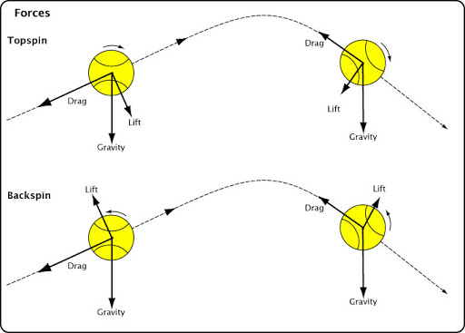
Uses?
Tennis players
Front Spin
Ball goes downward faster
Back Spin
Ball goes upward
Baseball!
Curve balls
Screwballs

Slide 28
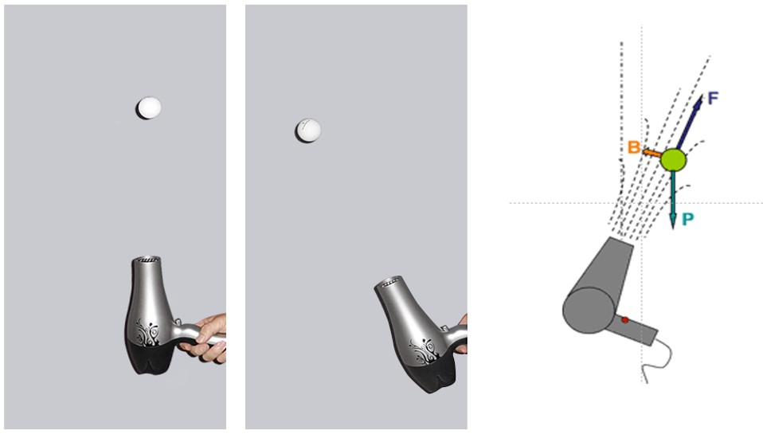
Do this at home or you get an f
Lots of backspin = Floating balls?
Floating ping pong ball also floats because of this!

Slide 29
Review
Name a few “forces” that act on a fluid.
What does Archimedes’ principle tell us?
What causes the Magnus force?

